Slide 1
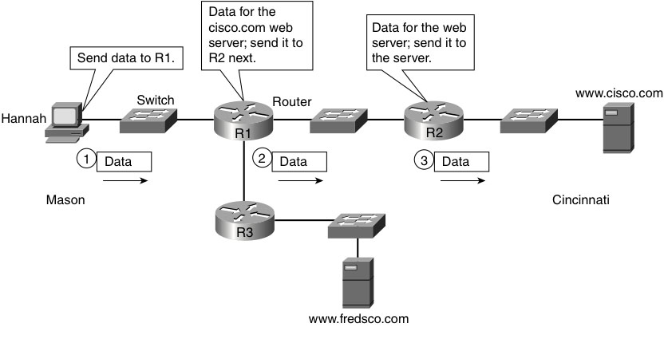
Routing
Routers are devices that sit at the intersections between two or more networks – shown as cylinder with arrows pointing to center
Act to interconnect those networks
Forward packets from one network to another
Can connect networks of same or different types
A group of mutually interconnected networks forms an internetwork, or internet
Routing is the process of moving data from its source to its destination across an internet
Notes:
Figure 10-1 from Computer Networking First-Step by Wendell Odom (ISBN: 1587201011) Copyright © 2013 Cisco Systems, Inc. All rights reserved.

Slide 2
Internet Protocol (IP)
Layer 3 protocol – defines internet addressing and rules for routing
IP addresses
Defined to simplify routing
32-bits – canonical (or dotted quad) notation – 4 decimal octets
132.177.4.208 is IP address of wcit.cs.unh.edu
132.177.137.6 is IP address of newton.unh.edu
Every network interface must have its own unique IP address
Most computers have only one
Routers have many
Host – any device with a functioning network interface that can send and receive IP packets

Slide 3
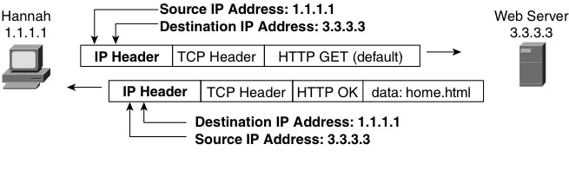
IP packets
IP header + data payload = IP packet
Packet is a Layer 3 term (datagram is also common)
Segment is a Layer 4 term
Frame is a Layer 2 term
IP header is 20-bytes long
Includes source and destination IP addresses
Data payload is often a TCP segment
IP provides for the end-to-end delivery of TCP segments
Connectionless, best-effort system
Notes:
Figure 10-3 from Computer Networking First-Step by Wendell Odom (ISBN: 1587201011) Copyright © 2013 Cisco Systems, Inc. All rights reserved.

Slide 4
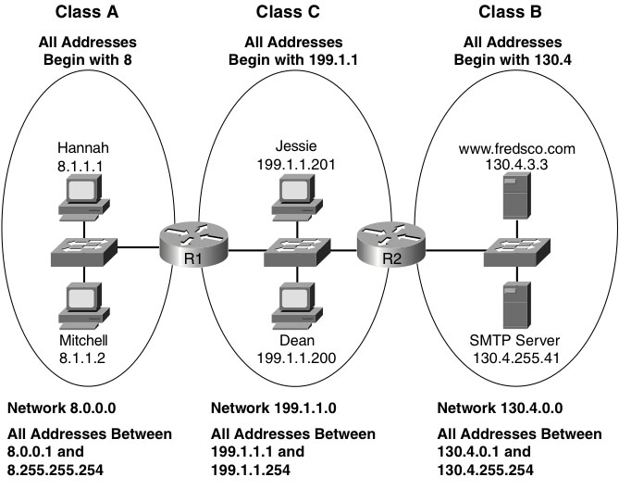
IP addresses
All IP addresses on the same physical network have an initial portion in common
IP network number – similar to a Zip code
Written like an IP address, but only shared portion is indicated, rest zeroes
Shared portion is called network portion, remainder is host portion
Simplifies routing
Routers don’t need to know where each individual address is, just where each network is
Class A
1 octet specified (1st is 0-127)
128 networks
16,777,216 addresses each
Class B
2 octets specified (1st is 128-191)
16,384 networks
65,536 addresses each
Class C
3 octets specified (1st is 192-223)
2,097,152 networks
256 addresses each
Notes:
Figure 10-7 from Computer Networking First-Step by Wendell Odom (ISBN: 1587201011) Copyright © 2013 Cisco Systems, Inc. All rights reserved.

Slide 5
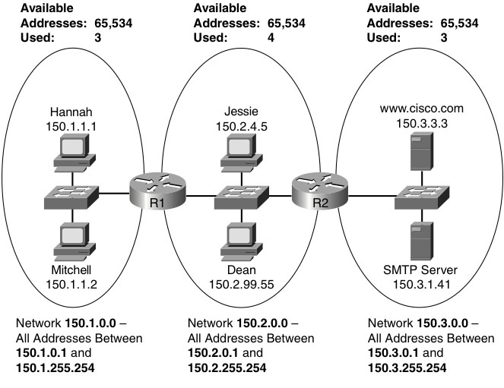
Limitations of IP addresses
Routers only work with network portion of IP addresses
Cannot distinguish individual hosts on a single IP network
So we need one IP network per physical network
But few physical networks need all their IP addresses
Many IP addresses are wasted
IPv4 provides at most 4,294,967,296 unique addresses
Over 20,000,000,000 devices on the Internet as of March 2016
Not enough, so wasted addresses should be minimized
Migrating to IPv6 which provides up to about 3.402 x 10³⁸ addresses
More than 7 addresses for every atom in every human body on the planet
Notes:
Figure 10-8 from Computer Networking First-Step by Wendell Odom (ISBN: 1587201011) Copyright © 2013 Cisco Systems, Inc. All rights reserved.
Additional details drawn from Wikipedia entry on IP address at http://en.wikipedia.org/wiki/IP_address as of 10/17/12.

Slide 6
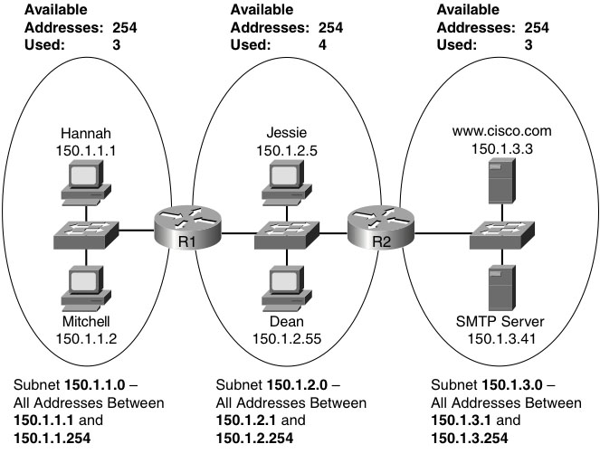
IP subnetting
Most LANs connect at most a couple hundred hosts
Using a class A or class B network for such a LAN would waste most of its addresses
Avoids wasting IP addresses by relaxing the rules
Allows IP networks to be subdivided into subnets
Each subnet gets treated as a separate network
Devices in same subnet cannot be separated by a router
Devices in different subnets must be separated by a router
Works by extending network portion of IP addresses into host portion
Each IP address on the subnet begins with the extended network portion
Notes:
Figure 10-9 from Computer Networking First-Step by Wendell Odom (ISBN: 1587201011) Copyright © 2013 Cisco Systems, Inc. All rights reserved.
Additional details drawn from Wikipedia entry on IP address at http://en.wikipedia.org/wiki/IP_address as of 10/17/12.

